Slide 1
Different Quantum Computing Architectures Affect Resulting Probabilistic Outputs

Slide 2
Team Members
Student
Ashish Kumar
Paula Medina
Client
Lewis Westfall
Capstone Faculty
Dr. Charles Tappert
Prof. Avery Leider

Slide 3
Introduction
The goal of this research is to show the affect on resulting probability when superdense coding algorithm runs on different quantum computing architects.
For this paper, we are going to run the circuit on IBM 5 qubit London and IBM 5 qubit Rome processor and will be connecting different qubits to see if the result differs.

Slide 4
Superdense Coding
Superdense coding, is a quantum information process that allows one person to send two classical bits to another person using only a single qubit of a pair of entangled qubits.
This protocol was first proposed by Bennett and Wiesner in 1992 and experimentally actualized in 1996 by Mattle, Weinfurter, Kwiat, and Zeilinger using entangled photon pairs
It is one of the underlying principle of secure quantum secret coding. The necessity of having both qubits to decode the information being sent eliminates the risk of eavesdroppers intercepting messages.

Slide 5
Quantum Logic Gates
Commonly used gates
Hadamard gate
Pauli-X gate
Pauli-Y gate
Pauli-Z gate
Phase shift gates
Swap gate
Controlled gates

Slide 6

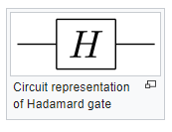

Hadamard Gates
Simplest gate involves one qubit and is called a Hadamard gate (also known as a square root of NOT gate). Used to put qubits into superposition
Circuit representation of controlled Hadamard gate

Slide 7

Controlled Gates
Controlled gates act on 2 or more qubits. For example, the controlled NOT gate (or CNOT) acts on 2 qubits, and performs the NOT operation on the second qubits only when the first qubit is |1> , and otherwise leaves it unchanged. It is represented by the matrix-
Circuit representation of controlled NOT gate

Slide 8
Software
Anaconda environment
Jupyter Notebook containing QISKit
IBM Q experience

Slide 9
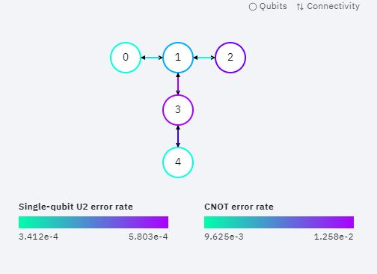
IBM 5 Qubit London Architecture

Slide 10
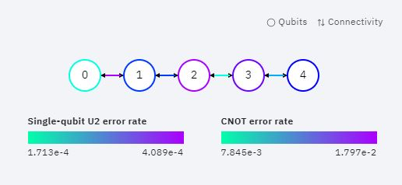
IBM 5 Qubit Rome Architecture

Slide 11
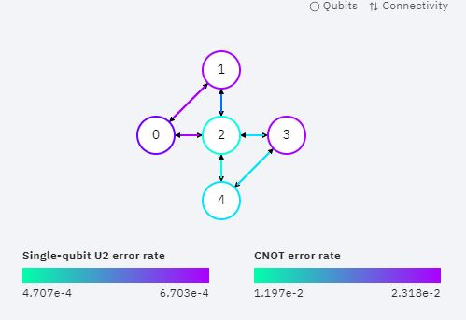
IBM 5 Qubit Yorktown Architecture

Slide 12
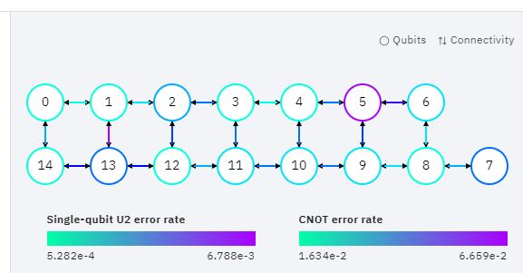
IBM 16 Qubit Melbourne Architecture

Slide 13
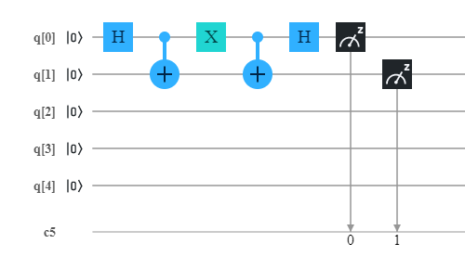
Circuit 1

Slide 14
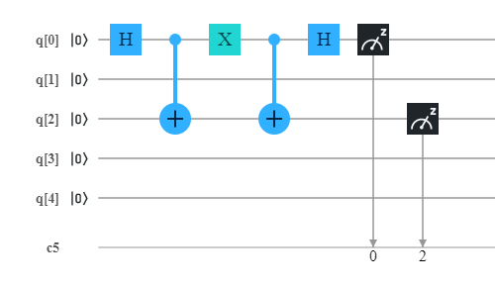
Circuit 2

Slide 15
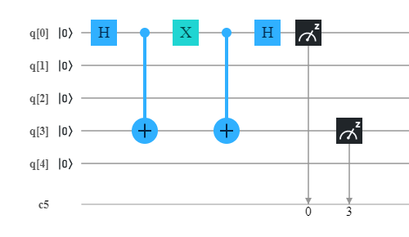
Circuit 3

Slide 16
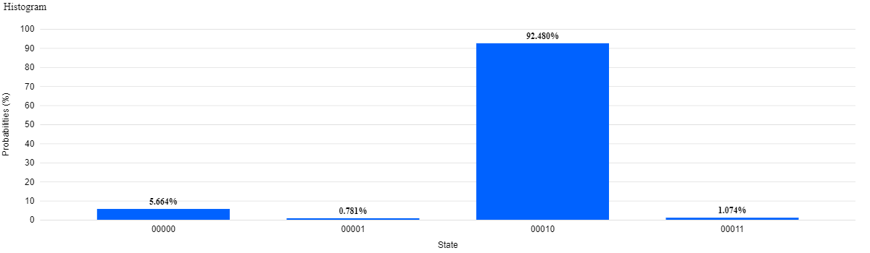
Result of Circuit 1
Result 1 IBM Rome

Slide 17
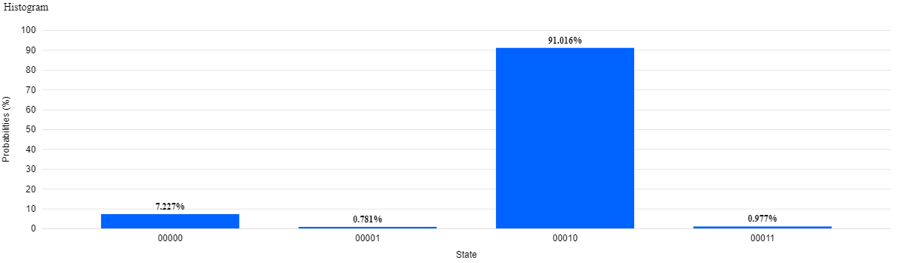
Result 1 IBM London

Slide 18
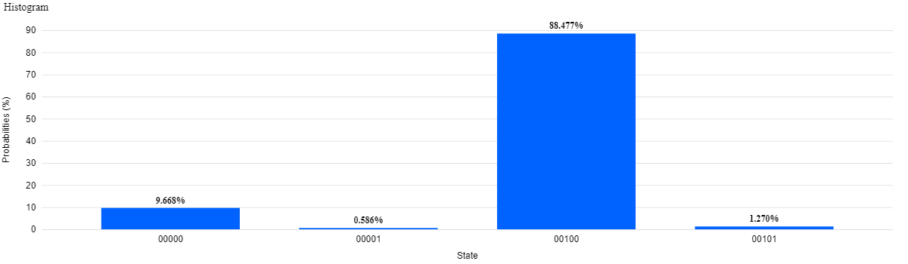
Result of Circuit 2
Result 2 IBM Rome

Slide 19
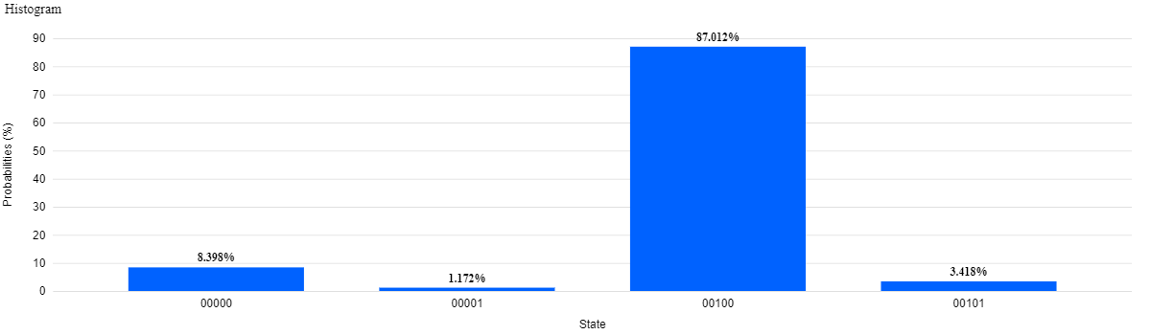
Result 2 IBM London

Slide 20
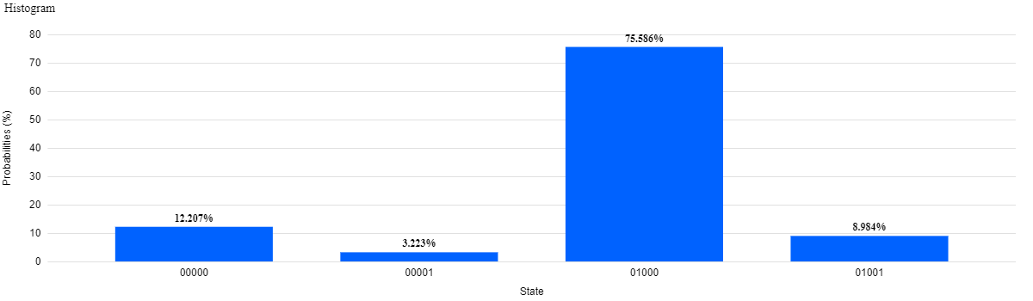
Result of Circuit 3
Result 3 IBM Rome

Slide 21
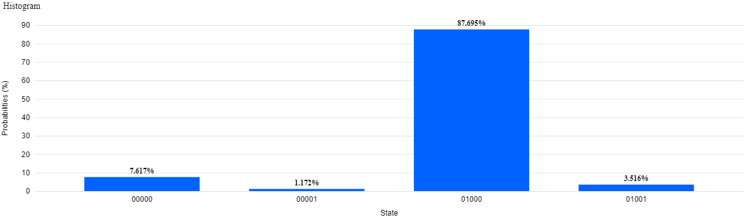
Result 3 IBM London

Slide 22
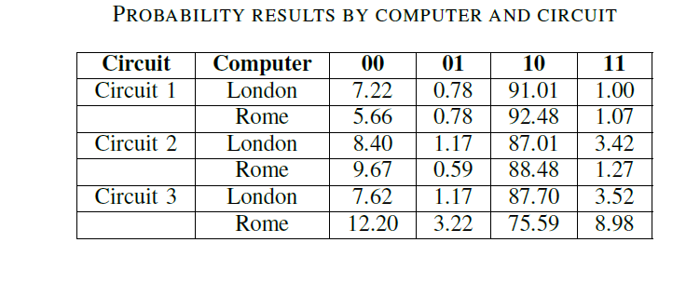

Slide 23
Conclusion & Future Work
The three circuits were constructed and run on the IBM's London and Rome quantum computers. The results show that the accuracy depends on how many qubits are between the qubits that are entangled.
In the future, similar tests should be run on IBM's Yorktown and Melbourne computers to test these different architectures. The tests should also be extended to test the performance of using qubits 0 and 4 as this will further explore the effects of qubit separation.

